Slide 1
Infinity 060
The Slimmer, Elegant Edge
The Style of Zero Energy

Slide 2
Benefits
Available in aluminum or plastic frame options
Clean, contemporary all-glass surface
Up to 50% more energy savings with plastic frame¹ vs. aluminum frame
No door or glass heat for lower operational and maintenance costs
Slim painted border for increased product visibility
¹Only for cooler reach-in cases

Slide 3
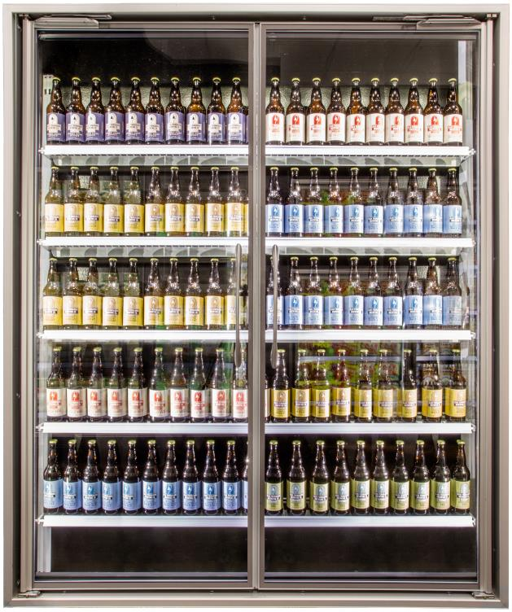
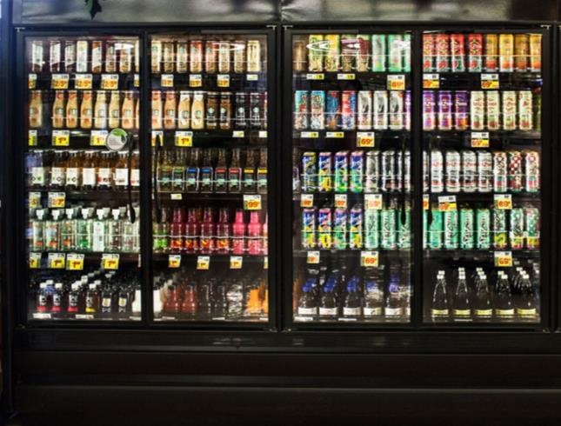
Cooler Application
Aluminum Frame
Cooler Walk-In or Reach-In Cases
Plastic Frame
Cooler Reach-In Cases

Slide 4
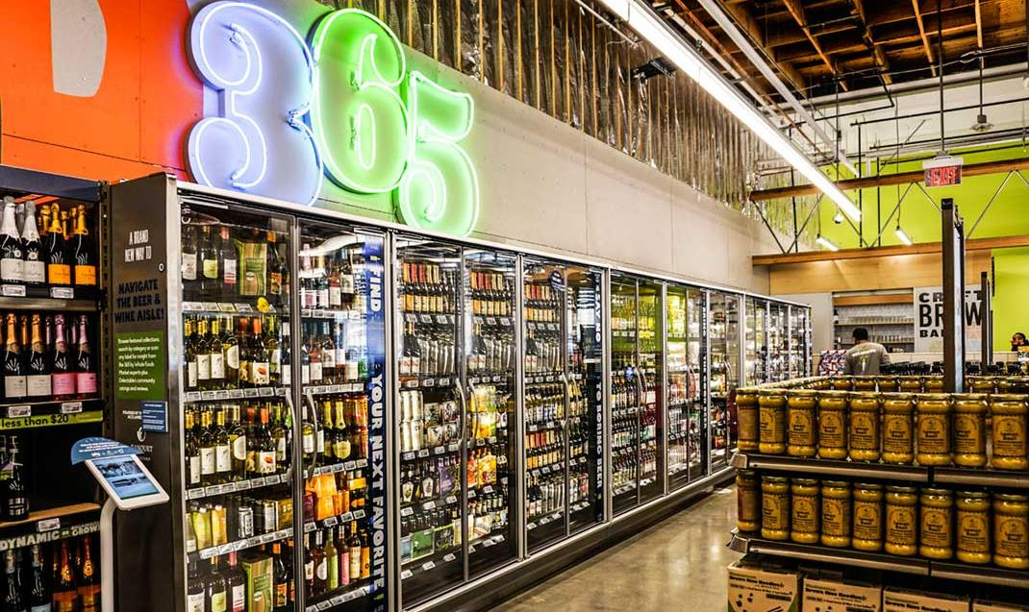
Infinity 060 at 365 by Wholefoods Market™
7% Increased Merchandising Visibility

Slide 5
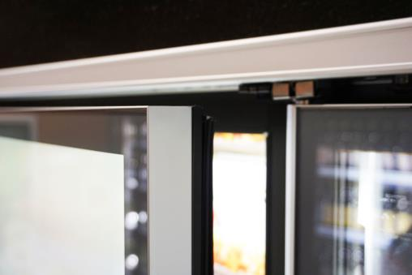
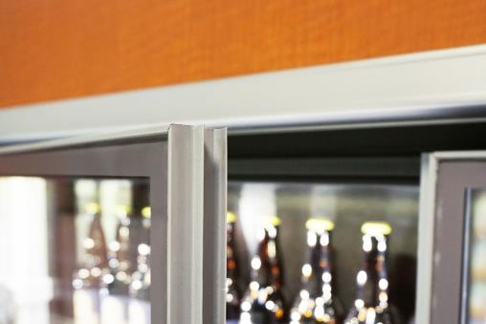
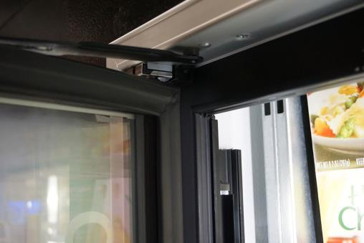
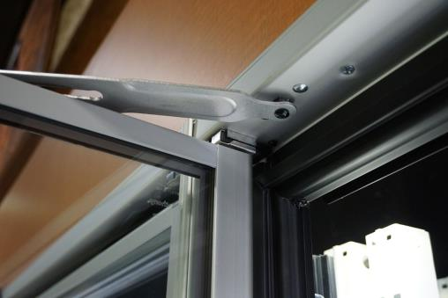
Visual Differences of Infinity Series
Infinity 060
Infinity 090
Infinity 060
3 Pane
2 Pane
0.90”
0.60”
Door Gasket
Frame Gasket
¹Nominal size is 0.60”, actual size is 0.62”

Slide 6
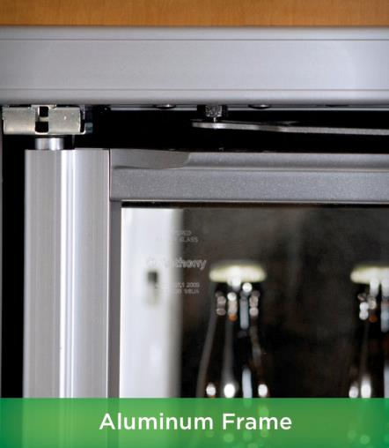
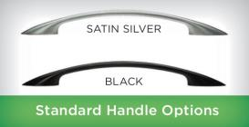
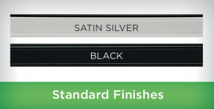
Standard Features & Applications Aluminum Frame
Infinity 060
Standard Features:
Zero Energy Door
Door Height: Up to 79”
Auto Hold-Open & Door Stop
Hinge Pin
Torque and Sag Adjust
Front-Loading Raceway and U-Shaped Mullion for Easy Service
Standard Shelving Kits
T-8 Lighting
Options
Optimax Pro 24 LED
Optimax Shelf LED
Anti-Fog
Energy Controller
POM Lock
French Door Swing
Advanced/Premium Shelving Kits
Applications:
Cooler Reach-In Cases and Walk-In
Notes:
Cloze Control Not Available

Slide 7
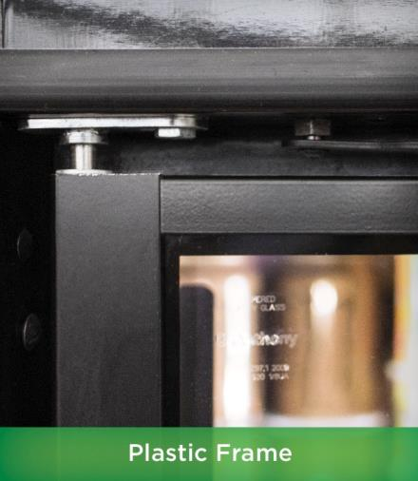
Standard Features & Applications Plastic Frame
Infinity 060
50% more energy savings with plastic frame vs. aluminum frame
Standard Features:
Zero Energy Door
Door Height: Up to 67”
Smaller Catalog Size
French Door Swing Only
No Shelves Included
Optimax Pro Plus LED
Spring Loaded Hinge
Auto Hold-Open and Door Stop
Torque and Sag Adjust
Options
Anti-Fog
Applications:
Cooler Reach-In Cases
Plastic Frame: Only for cooler reach-in cases
Notes:
Plastic frame provides more insulation, less frame heat

Slide 8
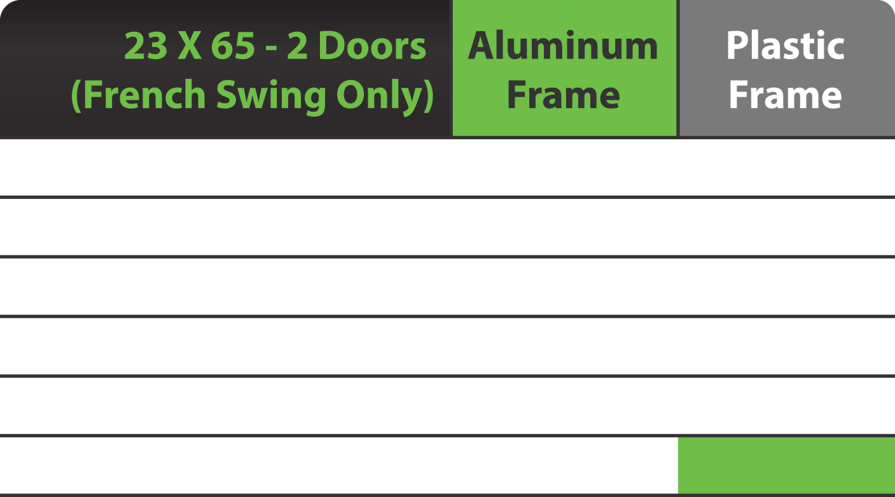
Plastic Frame Energy Savings
Infinity 060
Total Watts | 134 | 63
Annual KW-h | 1,177 | 553
Electric rate($/KW-h) | $0.12 | $0.12
Annual Operating cost | $141 | $66
Savings per Year | --- | $74
% Savings | --- | 53%
Includes: Door + Frame + LED Lights

Slide 9
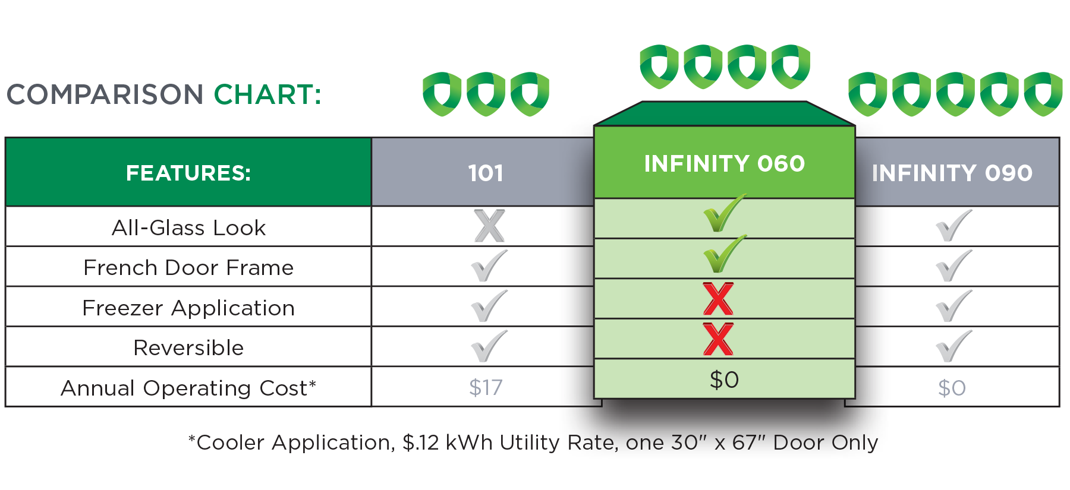
Door Comparison
Infinity 060

Slide 10
Order Infinity 060 Today www.anthonyintl.com
or by calling 800-772-0900

